Slide 1


Slide 2


Slide 3
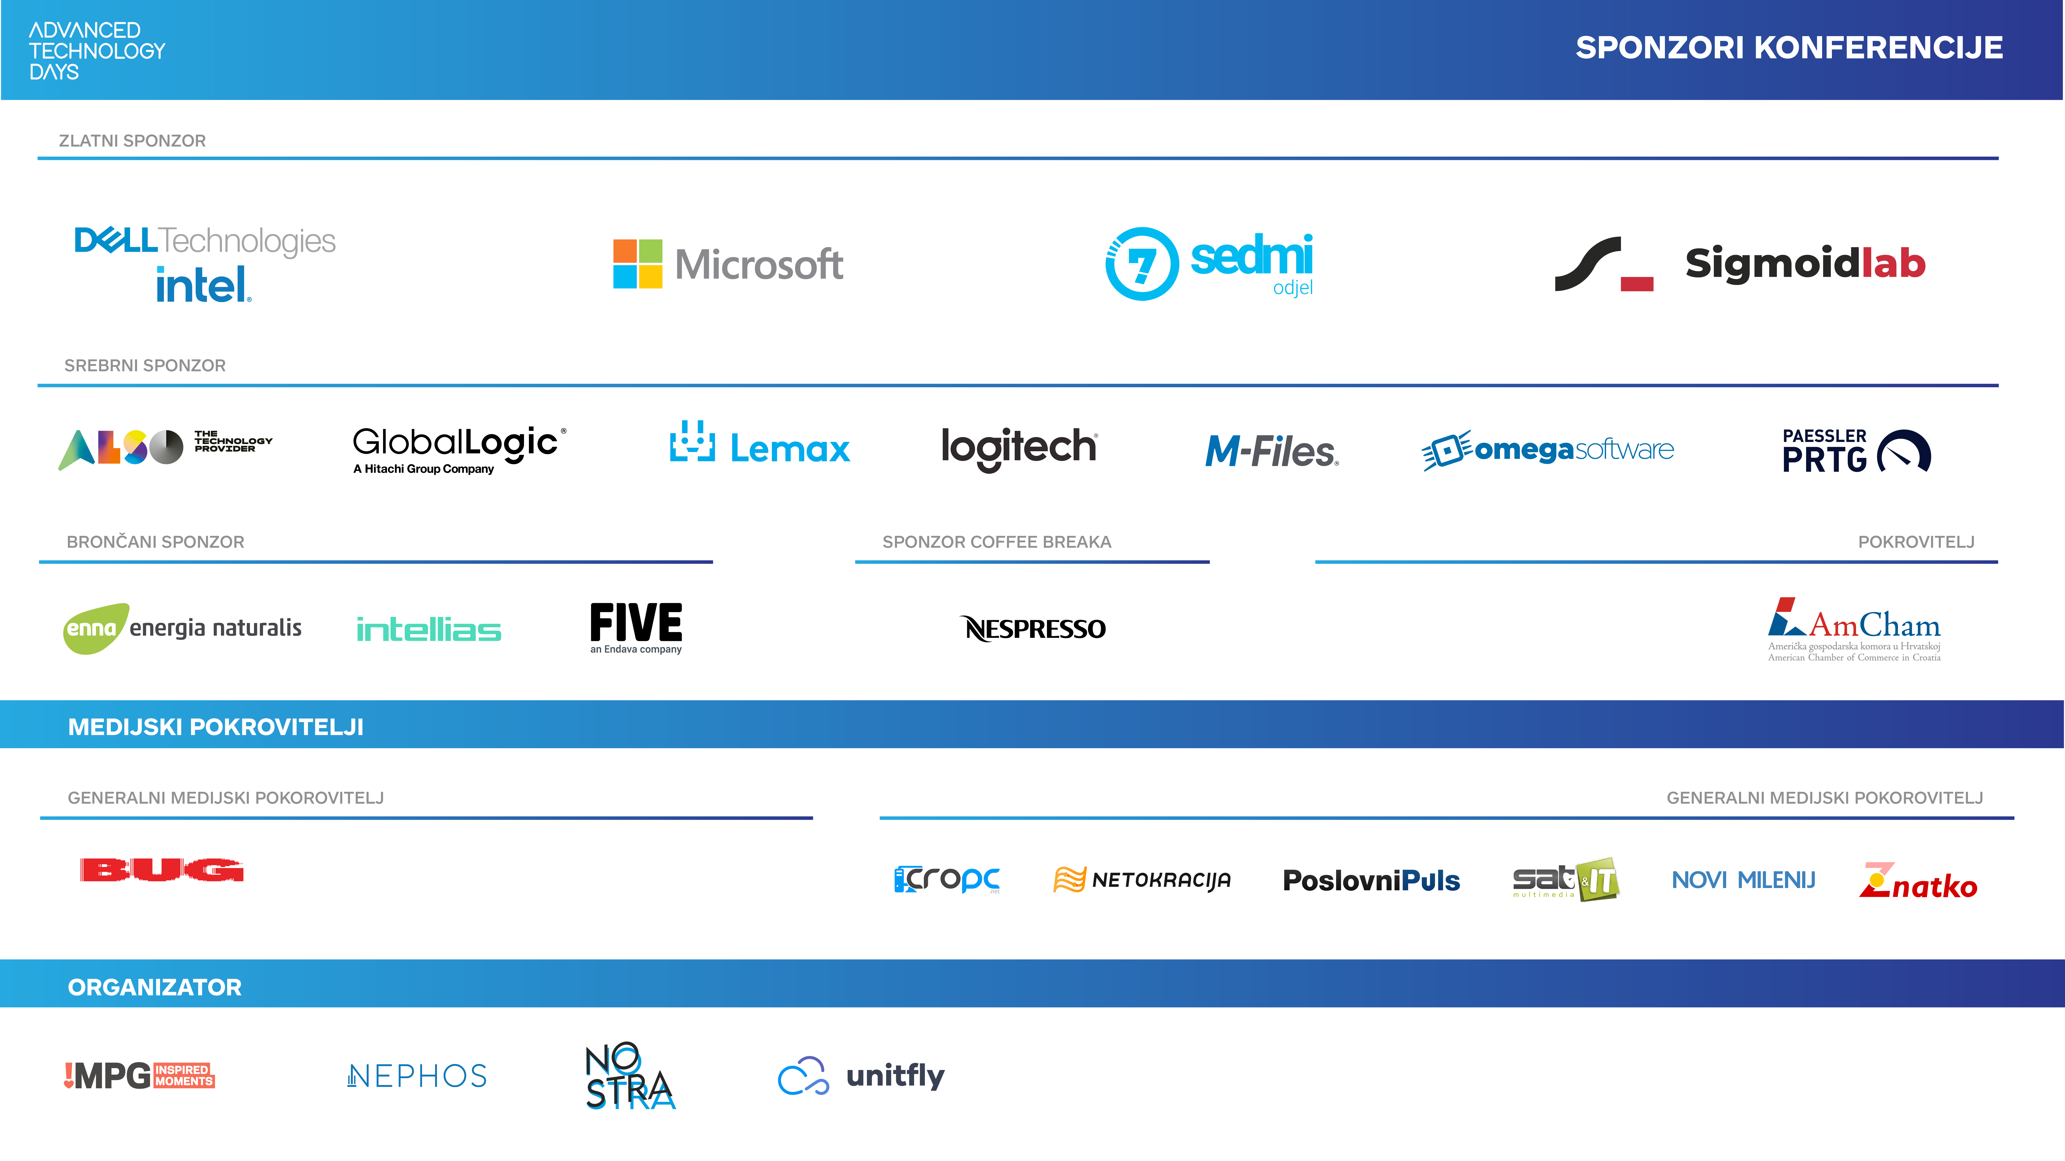

Slide 4
Building an auth microservice with ASP.NET Core Identity and Duende IdentityServer
Miroslav Popović Technical Lead @Seavus @miroslavpopovic
Notes:
Fonts used: Suisse Intl Regular and Suisse Intl Semi-Bold
Font made from <a href="http://www.onlinewebfonts.com">oNline Web Fonts</a> is licensed by CC BY 3.0
All graphics in this document are a copyright of https://initconf.org/.

Slide 5
Introduction

Slide 6
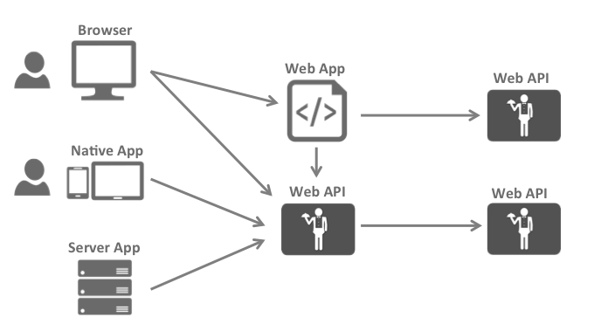
What modern apps look like?
Image taken from Duende IdentityServer documentation

Slide 7
Why an auth service?
Problems to solve:
Authentication
Authorization
Resource protection
Centralized solution
Auth service = Security Token Service

Slide 8


OAuth 2.0 & OpenID Connect
OAuth 2.0
Authorization
Granting access to data and features from one application to another
OpenID Connect
Authentication
Login and profile information
Notes:
Things to go through:
OAuth history
OpenID history
DotNetOpenAuth
OpenID Connect, built upon OAuth 2.0

Slide 9
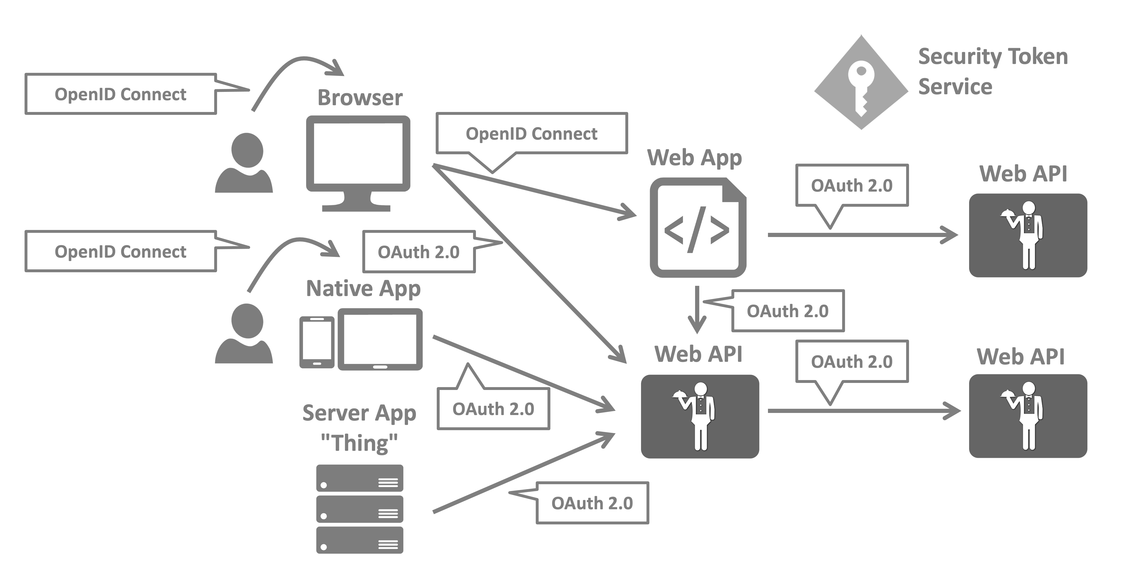
The big picture
Image taken from Duende IdentityServer documentation

Slide 10
Potential implementations
Cloud based
Auth0 / Okta
FusionAuth
Azure AD B2C
Self-hosted
https://www.keycloak.org/
https://www.ory.sh/
https://gluu.org/
Middleware
Duende IdentityServer
OpenIddict
Custom / built from scratch
?

Slide 11

ASP.NET Core Identity
Managing users, passwords, profile data, roles, …
DB persistence with EF Core
Predefined UI for login, register, forgot password, 2FA, …
UI Scaffolding
Support for external logins

Slide 12

Duende IdentityServer
Protect your resources
Authenticate users using a local account store or via an external identity provider
Provide session management and single sign-on
Manage and authenticate clients
Issue identity and access tokens to clients
Validate tokens

Slide 13
Terminology

Slide 14
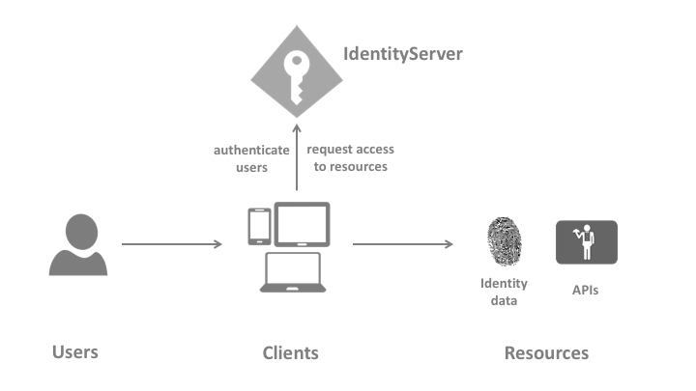
Basic concepts
ASP.NET Core Identity
+

Slide 15
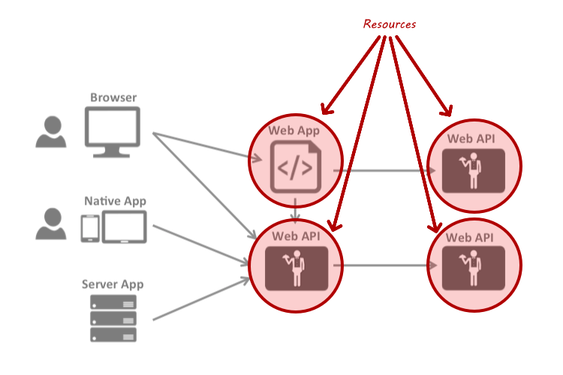
Resources
Identity resources
API resources
Notes:
Identity resources
Claims about the user – user ID, name, email…
Named group of claims that can be requested with scope parameter
API resources
A functionality client wants to access
Group of scopes – logical API

Slide 16
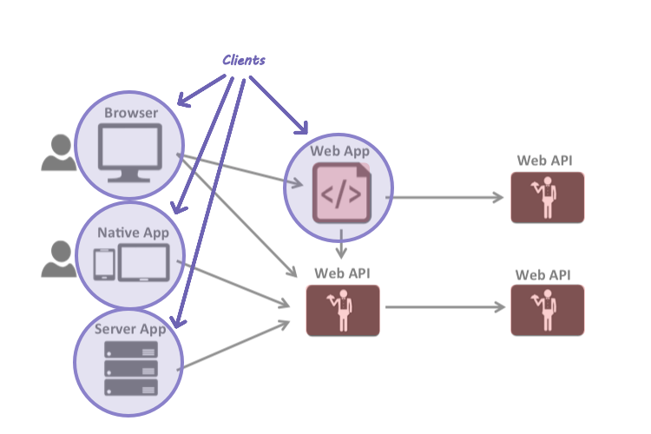
Clients
Accesses to resources
Need to be authorized

Slide 17
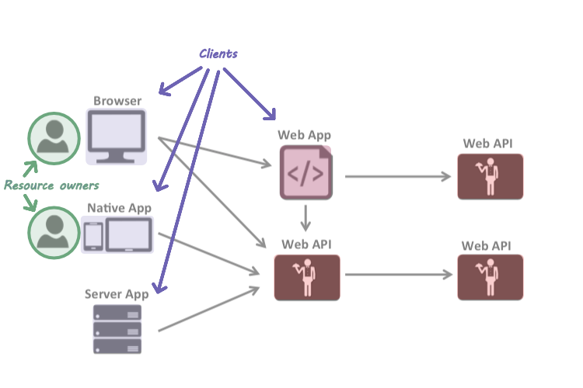
Resource owners
In most cases, users

Slide 18
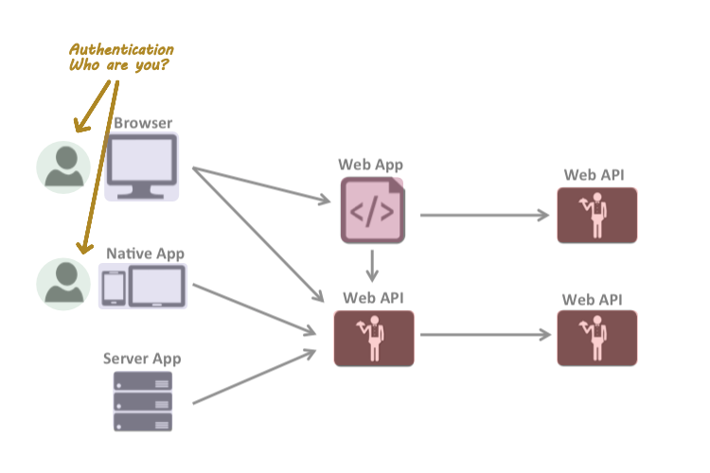
Authentication
Confirming user identity

Slide 19
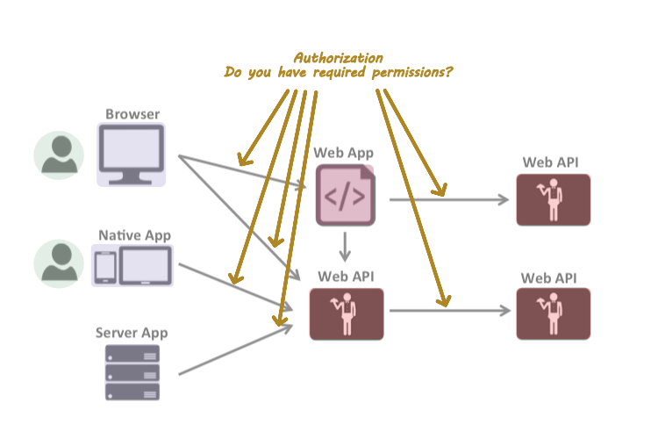
Authorization
Allowing the access to a specific functionality or resource

Slide 20
Other terms
Claim
One piece of information
Scopes
Something you want to protect and client wants to access
Grant types / flows
Non-interactive – client credentials flow
Interactive – authorization code flow with PKCE
Older flows are considered obsolete
Tokens
Access token – JWT
Refresh token
Identity token – JWT
Reference tokens (instead of JWT)

Slide 21
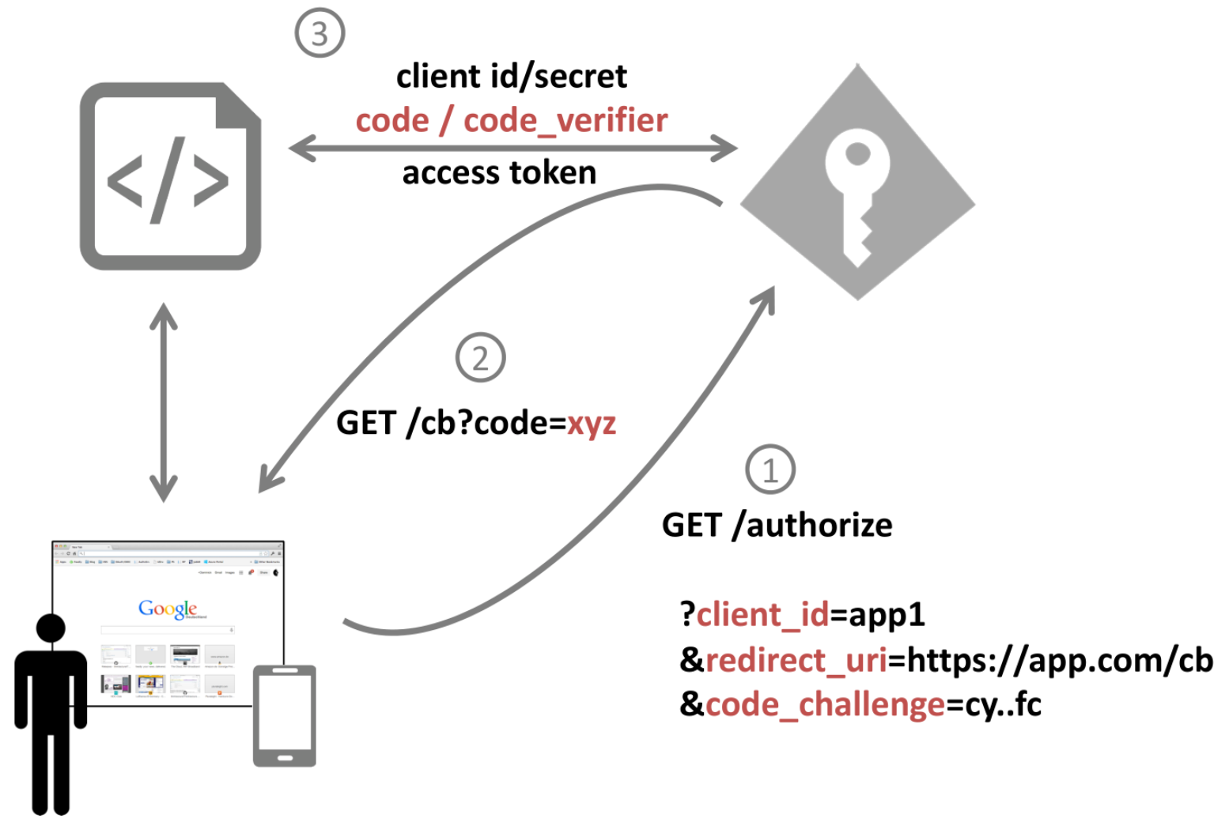
Authorization code flow with PKCE
code_verifier = random
code_challenge = hash
Image taken from IdentityServer4 workshop by Dominic Baier
Notes:
https://identityserver.io/training/
PKCE = Proof Key for Code Exchange

Slide 22
Demo

Slide 23
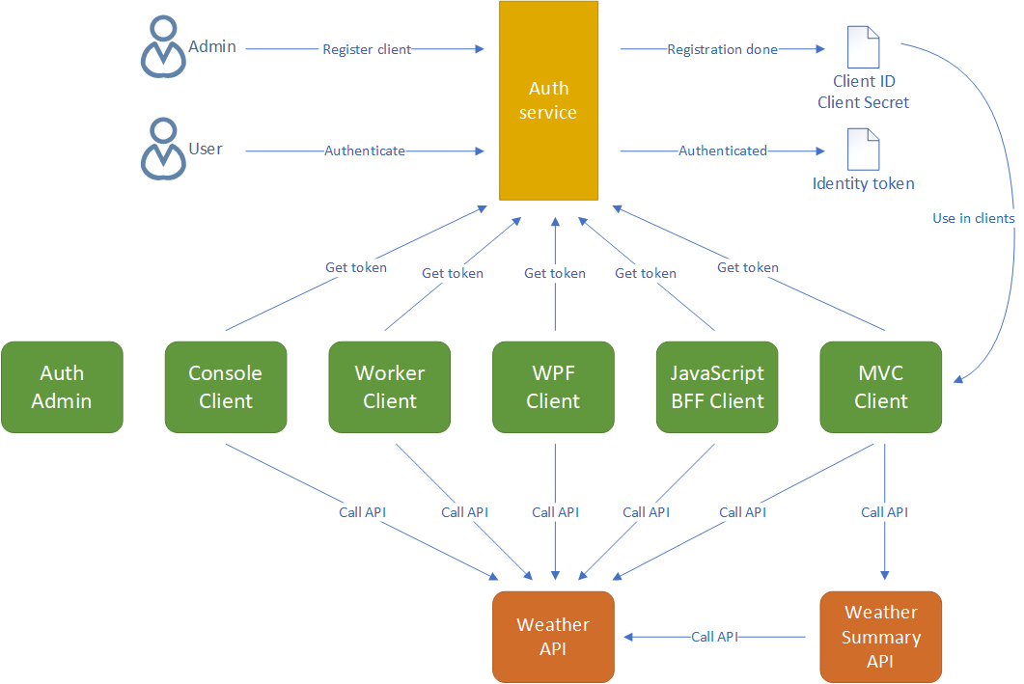

Slide 24
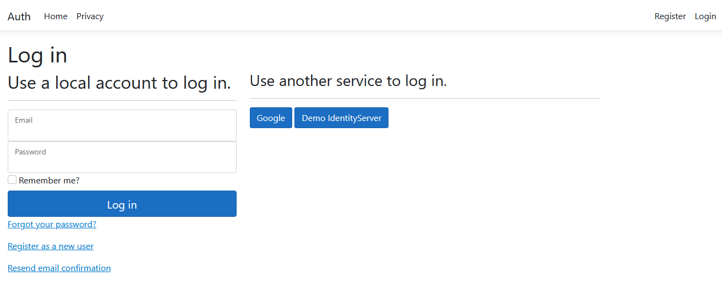
New ASP.NET Core project with Identity
Implement 2FA auth
Implement email service with MailKit
Extend IdentityUser
Notes:
- Don’t trust external authentication providers to always return claims that you need – ask the user to fill in the data on first login – i.e. email, display name, etc.

Slide 25
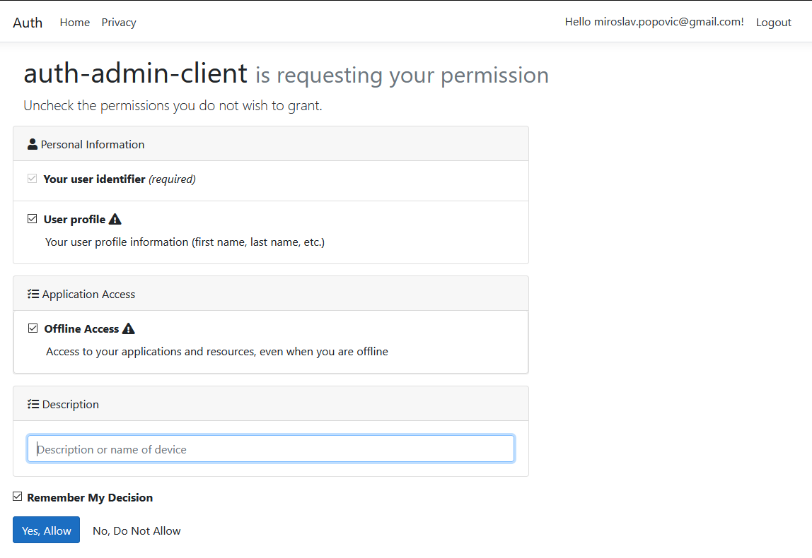
Including Duende.IdentityServer.AspNetIdentity
Configuring middleware
Defining resources
Defining clients
Configuring Consent page
Configuring Device Authorization page
/.well-known/openid-configuration

Slide 26
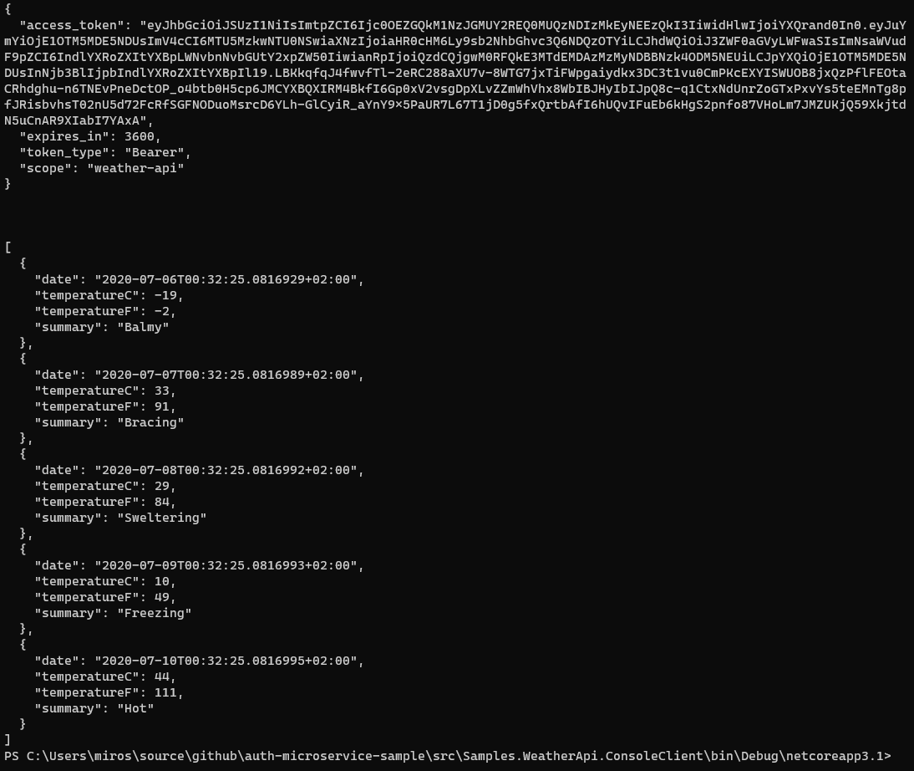
Console / Worker Client
IdentityModel library
Duende.AccessTokenManagement

Slide 27
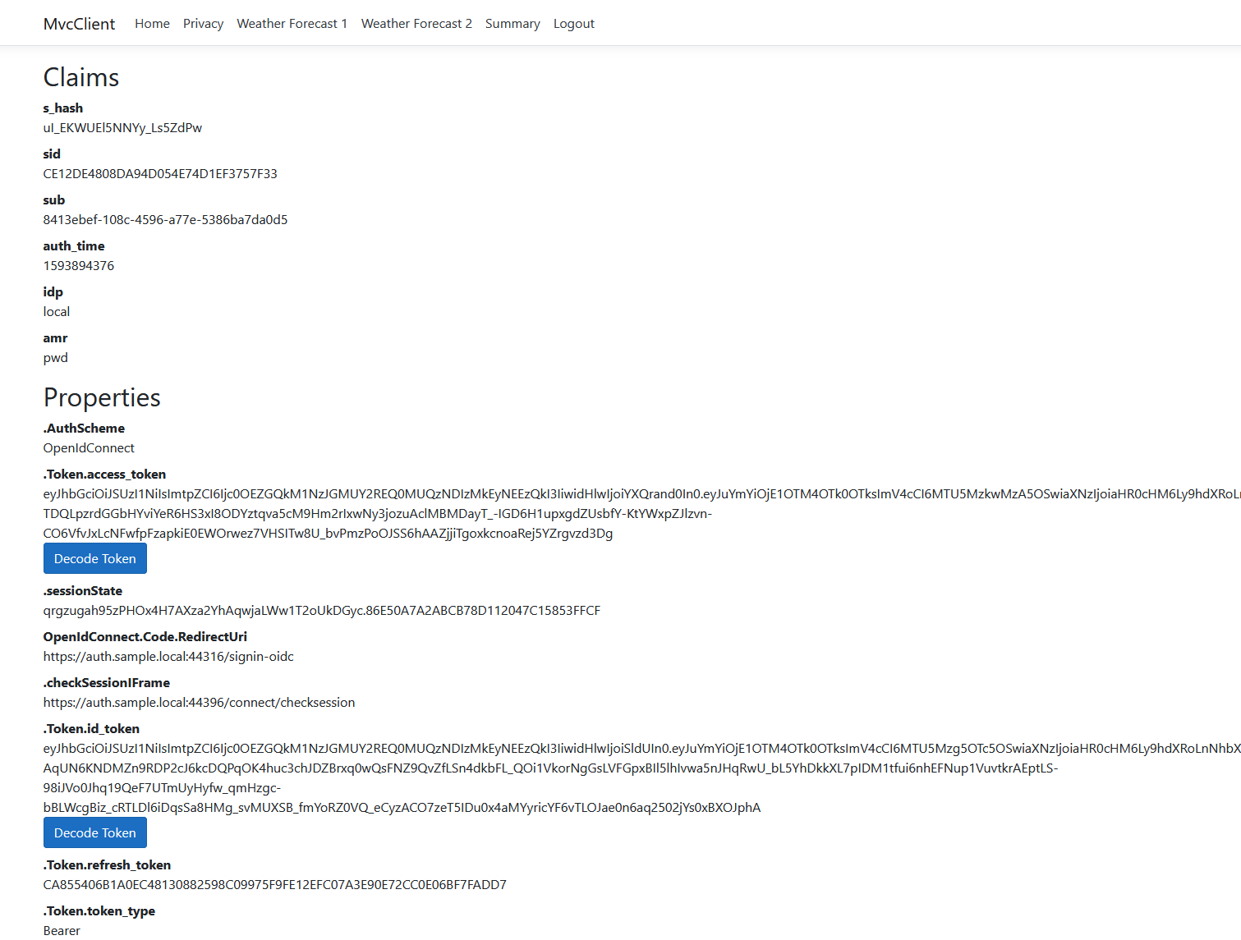
MVC client
Scenarios:
Same token for MVC app and API
Getting new token for API
Calling API through another API

Slide 28
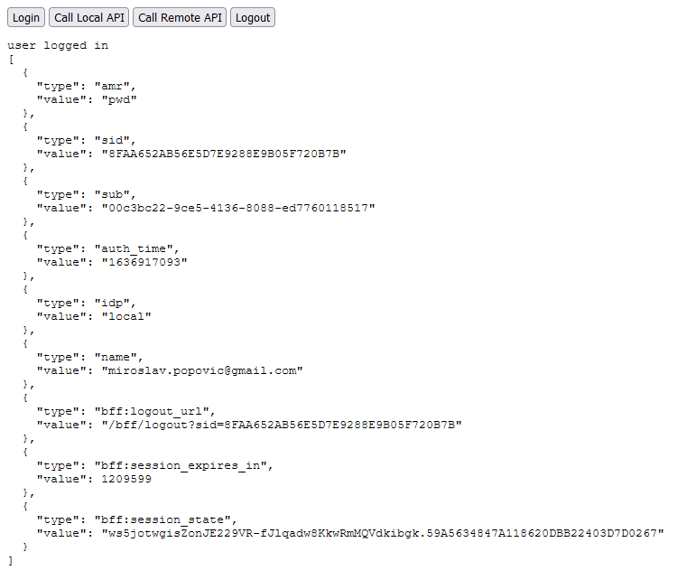
JavaScript BFF client
Duende.BFF – part of Business Edition or higher

Slide 29
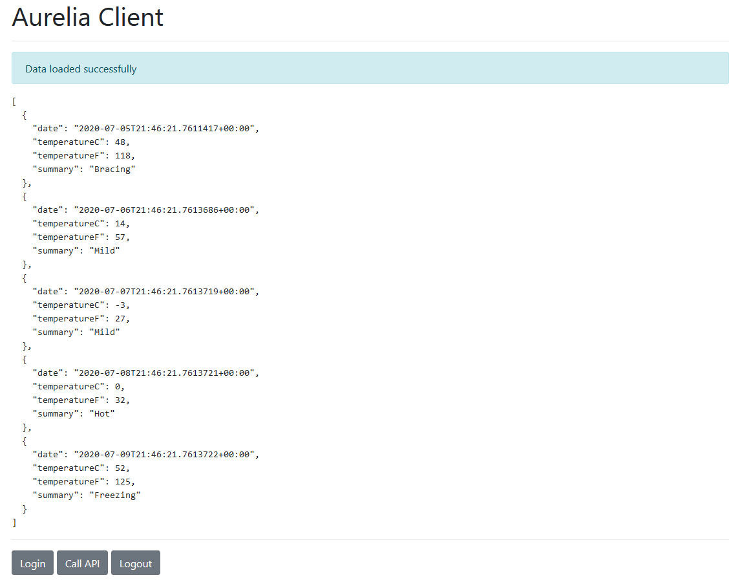
SPA client
Uses oidc-client library
Not recommended when working with sensitive data

Slide 30
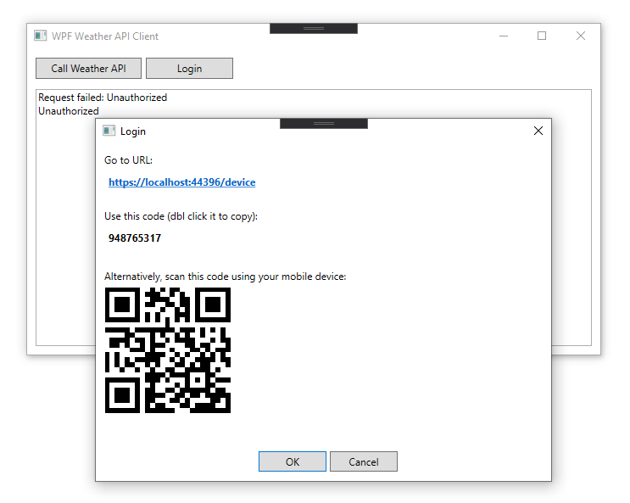
Device Client
Intended for devices without easy input
i.e. smart TVs, gaming consoles…
Simulated with WPF
RFC 8628

Slide 31
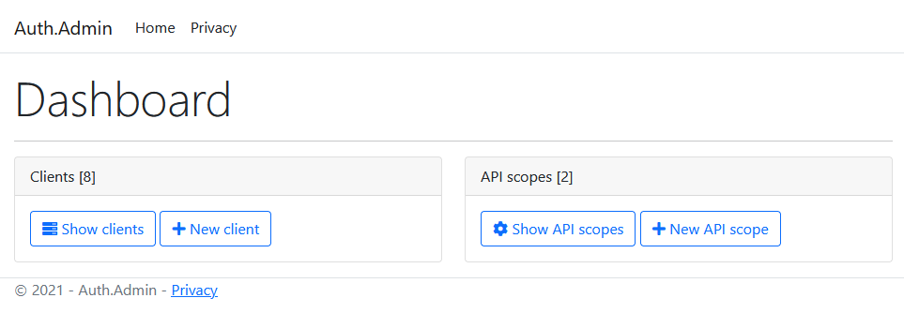
Switching to DB resources / clients
Adding Admin interface

Slide 32

Containerization
Docker
Docker Compose
Project Tye

Slide 33
Tips & tricks

Slide 34
Tips & tricks 1
Don’t add many claims to access tokens
Don’t include sensitive data to JWT tokens
Don’t store tokens to localStorage in browser-based apps if you are working with sensitive data
Use BFF architecture for browser-based apps
Use authorization code flow with PKCE for native apps too
Use rotation for refresh tokens (default behavior) and prevent reply attacks

Slide 35
Tips & tricks 2
Handle new users in external auth callback
i.e. ask them to fill in the data, don’t trust that provider will return it
Use IdentityModel library for .NET clients
Use IdentityServer as Federation Gateway
Create the strategy for encryption key rotation – implemented by default in Duende IdentityServer
Look into IdentityServer log output when resolving issues

Slide 36
Advanced
Single-sign on
Single-sign out
Complicated – front-channel, back-channel
Not all external providers support it
New server-side Session Management
Added in IS 6.1
Can be used instead of cookies
Key material
AddSigningCredentials, AddDeveloperSigningCredential, AddValidationKey
Proof of possession tokens
Bound to client that requested the token
Notes:
https://blog.duendesoftware.com/posts/20220406_session_management/

Slide 37
Closing words

Slide 38
What comes in future
OAuth 2.1
.NET 8
Duende
Duende IdentityServer 7?

Slide 39
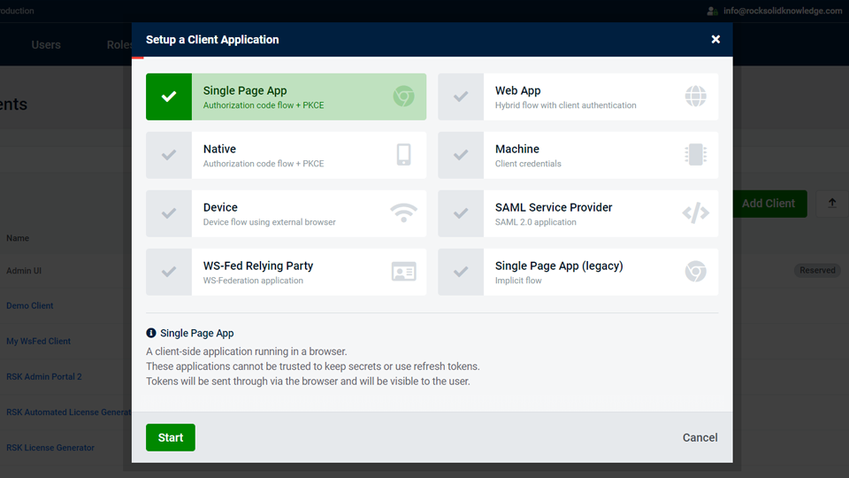
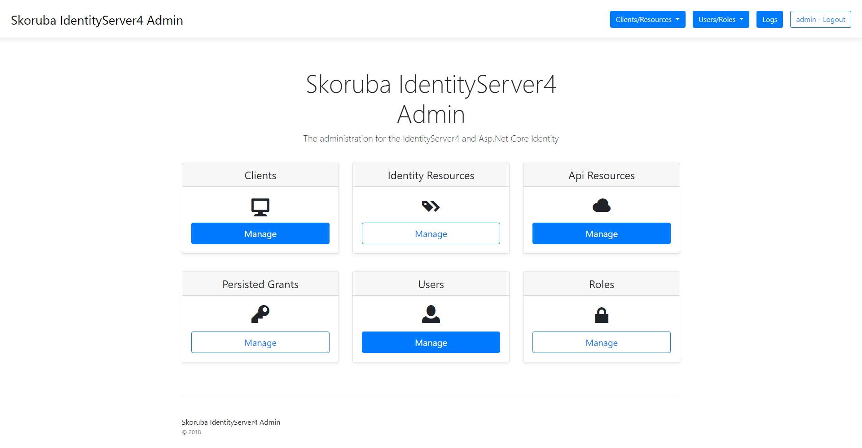
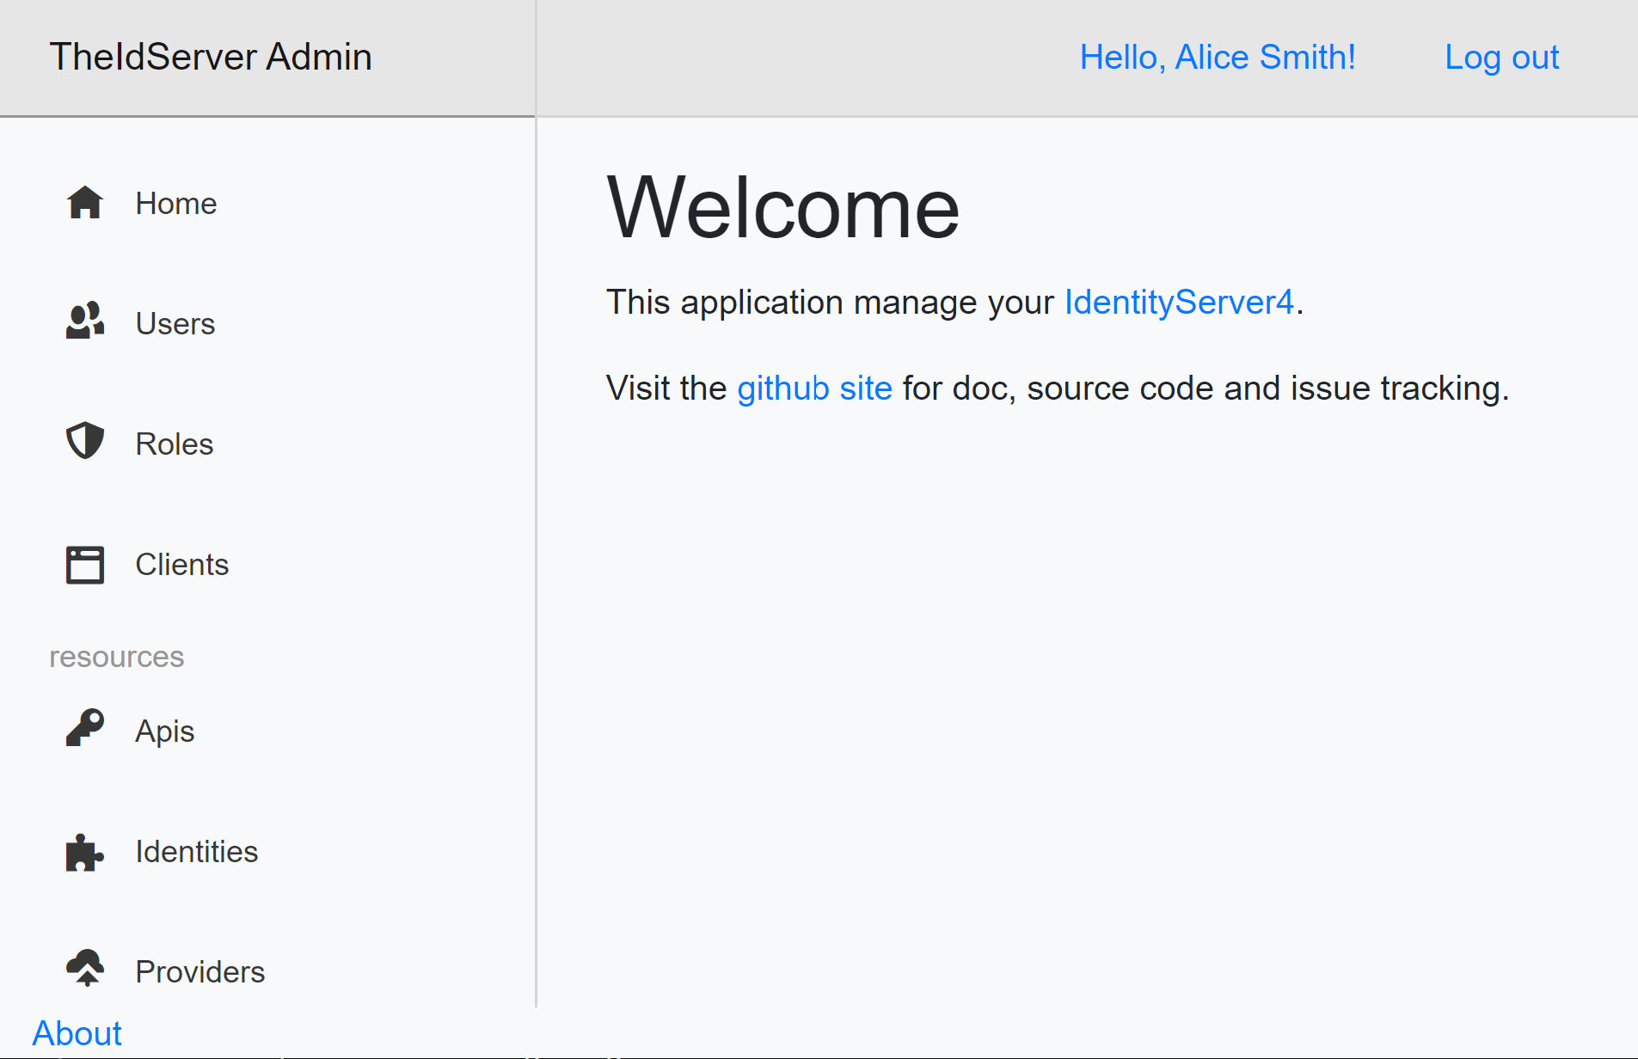
More things to look at
Admin interfaces
https://www.identityserver.com/products/adminui
https://github.com/skoruba/Duende.IdentityServer.Admin
https://github.com/Aguafrommars/TheIdServer
Policy / permission servers
https://solliance.net/products/policyserver
https://github.com/Xabaril/Balea
Samples on GitHub
/miroslavpopovic/auth-microservice-sample-dotnet7
/miroslavpopovic/auth-sample-openiddict

Slide 40
References
IEFT: OAuth 2.0 Security Best Current Practice Draft
ASP.NET Core Identity documentation
Duende IdentityServer documentation
Duende Software blog - https://blog.duendesoftware.com/
Dominick Baier’s blog - https://leastprivilege.com/
Brock Allen’s blog - https://brockallen.com/
IdentityServer workshops - https://duendesoftware.com/training/identityaccesscontrol
NDC Conferences YouTube channel
Search for “IdentityServer”, or “Dominick Baier”, or “Brock Allen”
Pluralsight
Securing ASP.NET Core 6 with OAuth2 and OpenID Connect

Slide 41
https://github.com/miroslavpopovic/auth-microservice-sample-dotnet7
https://github.com/miroslavpopovic/auth-sample-openiddict
@miroslavpopovic https://miroslavpopovic.com/ https://github.com/miroslavpopovic/

Slide 42
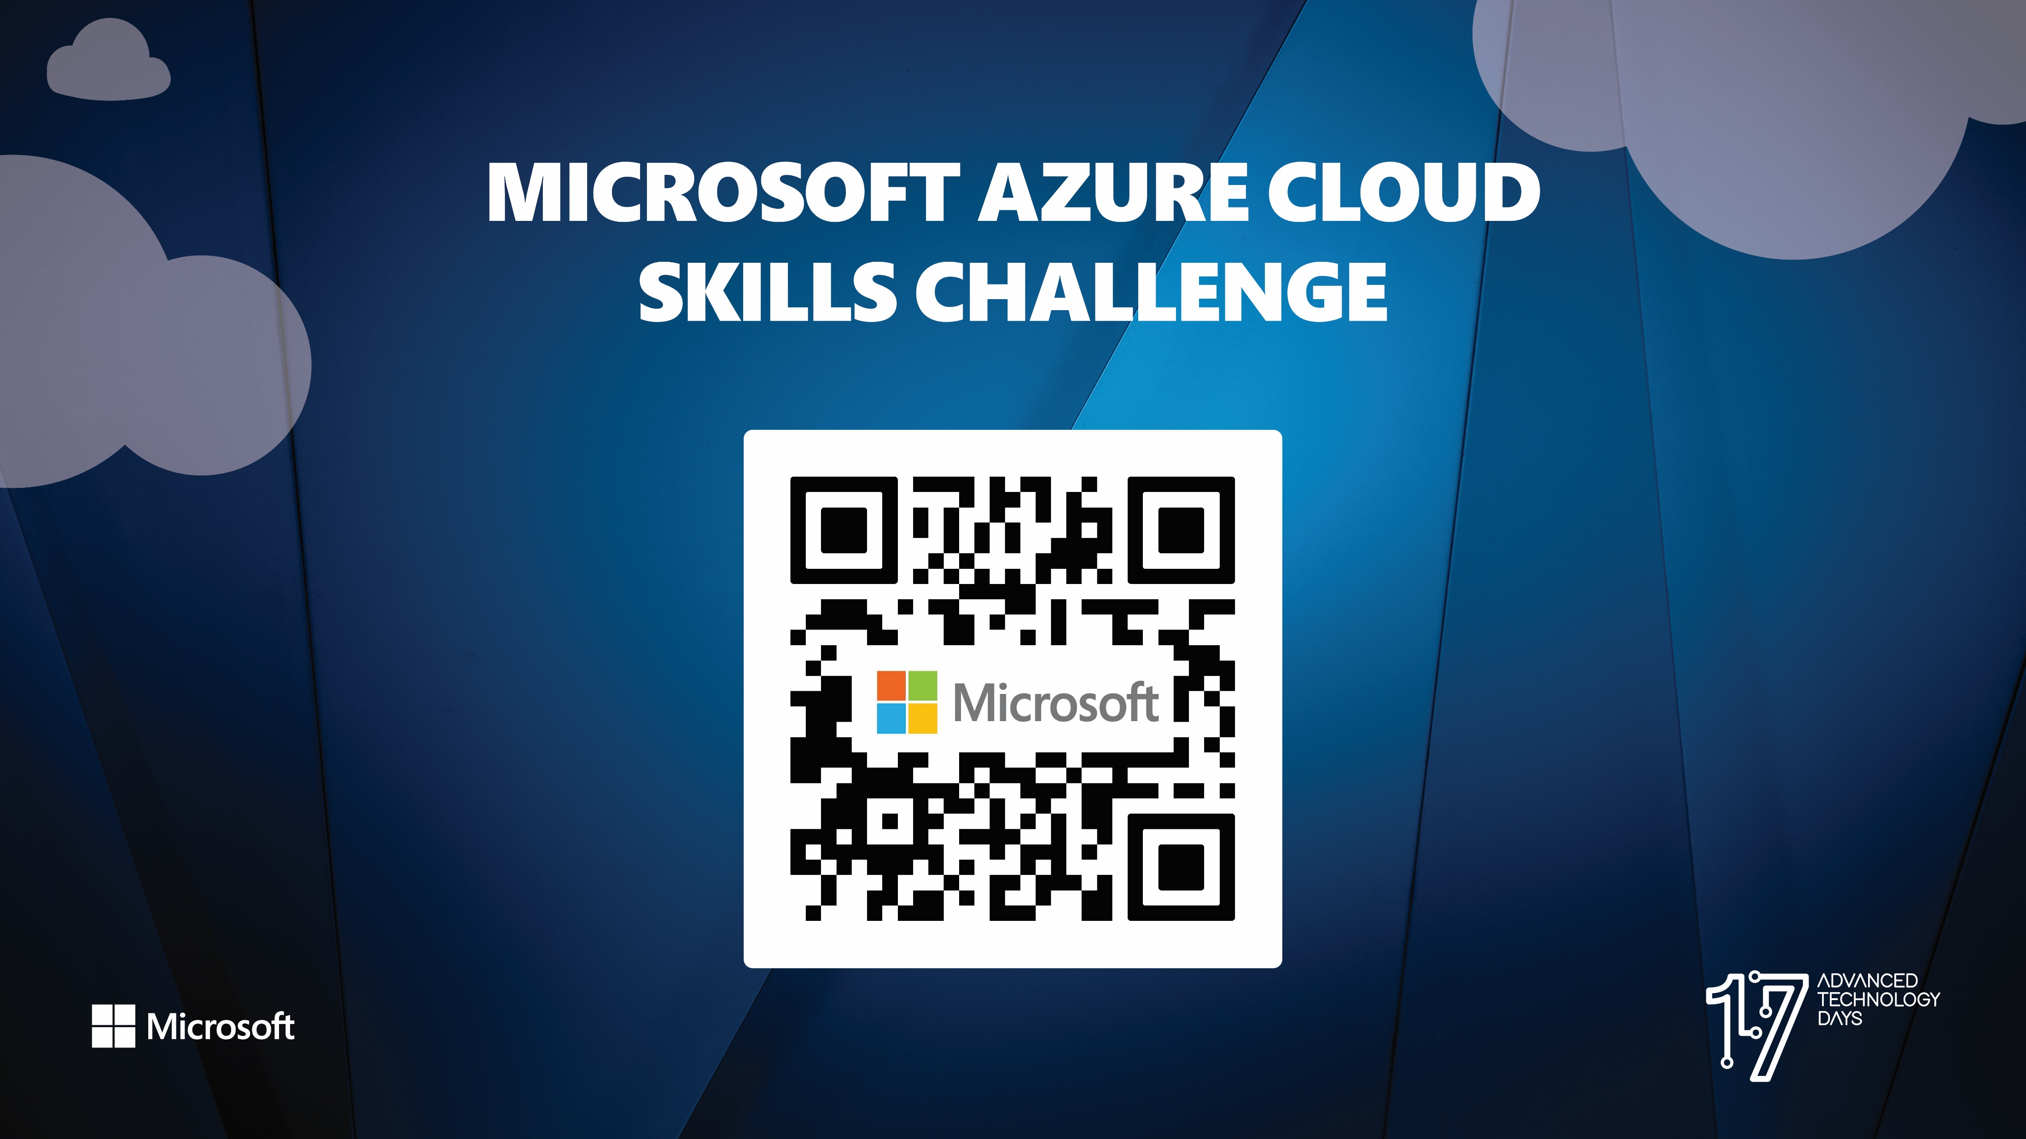

Slide 43


Slide 44


